Slide 1

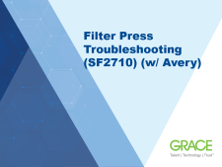
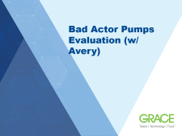




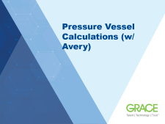

Projects Overview
¿Questions?

Slide 2
Internship Presentation
Patrick Herke
June 28, 2021

Slide 3
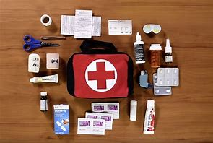
SPACER
Safety Topic: First Aid

Slide 4
Intern Summary Slide
Name: Patrick Herke
School and Year in College: Junior at Louisiana State University
Major: Mechanical Engineering
Project Title: Technical Intern, Mechanical Engineering
Team/Department: Maintenance
Supervisor: Todd Stephens
Fun fact: I write normally with my right hand, but
What Did You Learn?
Key Findings Results
Impact on The Business
Troubleshooting & parts sourcing
Pumps (sealed and magdrive)
Pressure Vessel Code Calcs
Accessible documentation
Easier Pump Troubleshooting
Conversion of ~7,900 documents
PSD audit
Code Calcs for 3 Vessels

Slide 5
Name: Patrick Herke
School and Year in College: Junior at Louisiana State University
Major: Mechanical Engineering
Project Title: Technical Intern, Mechanical Engineering
Team/Department: Maintenance
Supervisor: Todd Stephens
Fun fact: I write normally with my right hand, but
What Did You Learn?
Key Findings Results
Impact on The Business
Troubleshooting & parts sourcing
Pumps (sealed and magdrive)
Pressure Vessel Code Calcs
Document management
Plant layout & PSD types
Material incomp-atibility with process
Pump failure summary report
Code Calcs for 3 Vessels
Conversion of ~7,900 documents
PSD audit
Cost savings on order of ~50k/year
Easier Pump Troubleshooting
Calculate remaining life & audit compliance
Accessible documentation
Better inventory management of PSDs

Slide 6
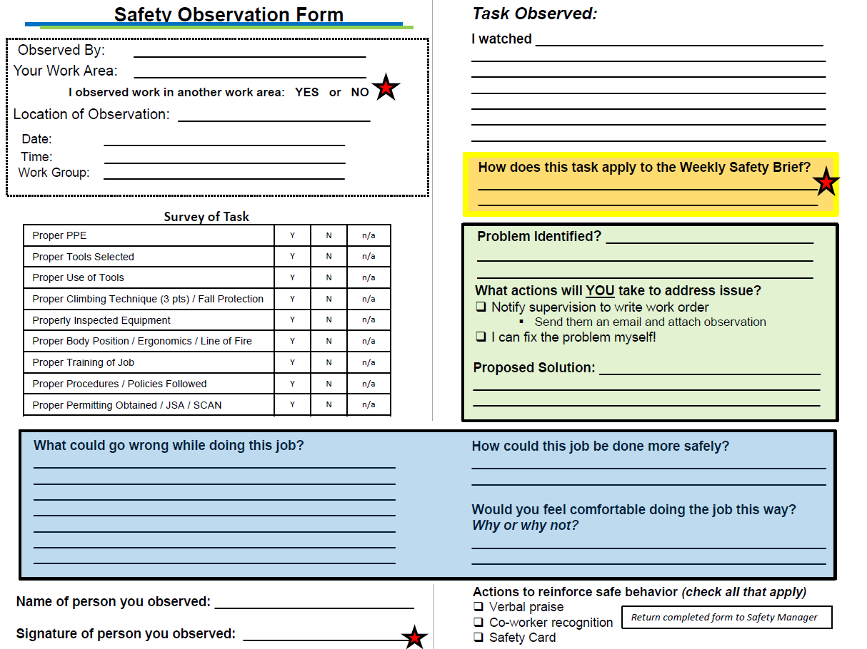
Safety
Safety Tailgates
June XX – Sleep deprivation
July 24 – First aid kit and medications
Weekly Safety Observations
Observe work
Evaluate safety
Figure 1

Slide 7
Overview of Projects
Projects
Filter Press Troubleshooting (SF2710) (w/Avery)
Pressure Vessel Calculations (w/Avery)
Rupture Disk Audit
Specifications and Standards Overhaul
Bad Actor Pumps Evaluation (w/ Avery)
Vendor Visits
Miscellaneous
Notes:
-list of major projects I worked on this summer

Slide 8
Filter Press Troubleshooting (SF2710) (w/ Avery)

Slide 9
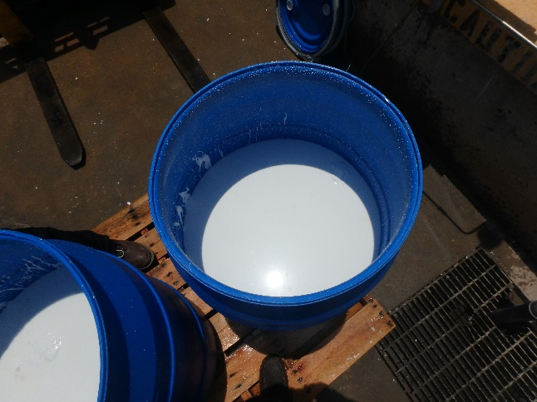
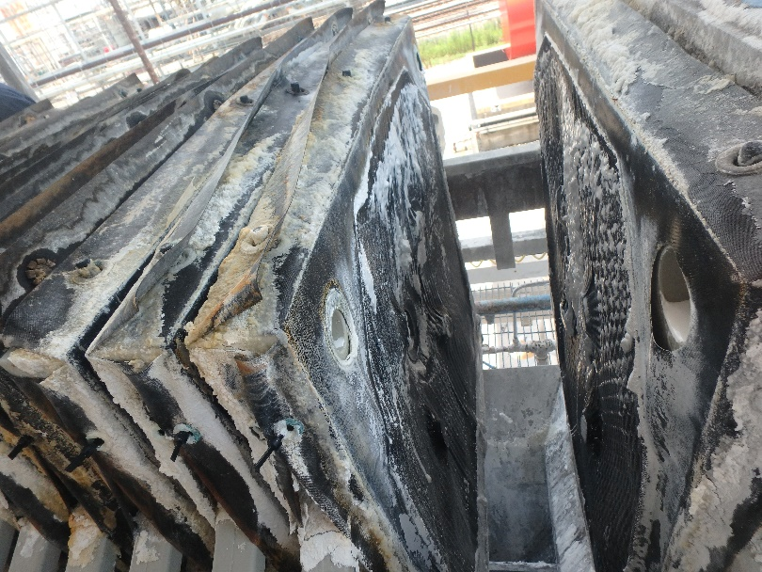
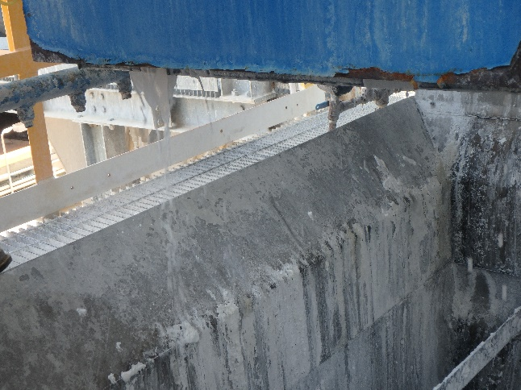
Filter Press Troubleshooting (SF2710) (w/Avery)
Problem
Plates warping
Leaking
Bypassing filter
High liquid content in cakes
Replacing every 2-4 months
Figure 2
Figure 3
Figure 4
Notes:
Warping results in leaks and high liquid content in the cakes left behind
$12,000
Cloths should be cleaned (using a high pressure wash using water OR a recirculating a particulate dissolving solution within the press) or replaced as soon as they start blinding.

Slide 10
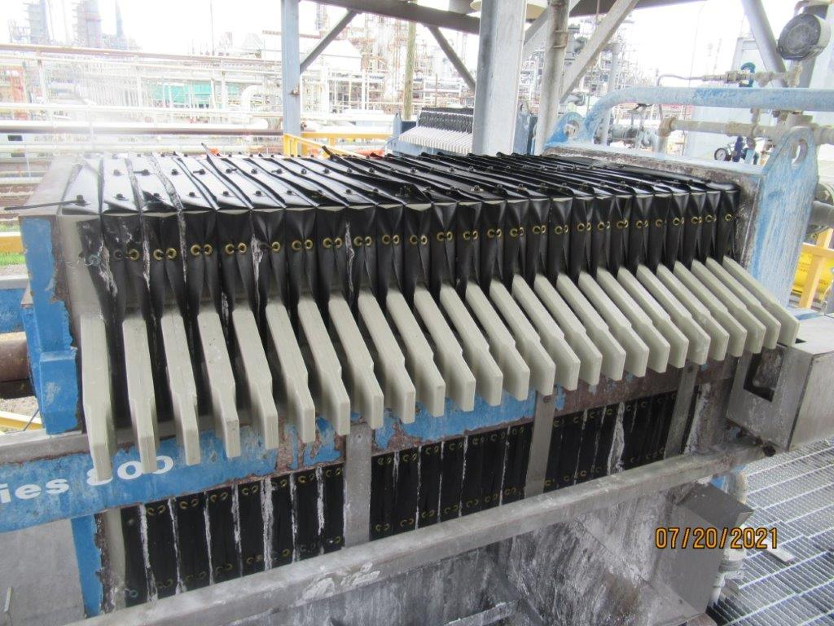
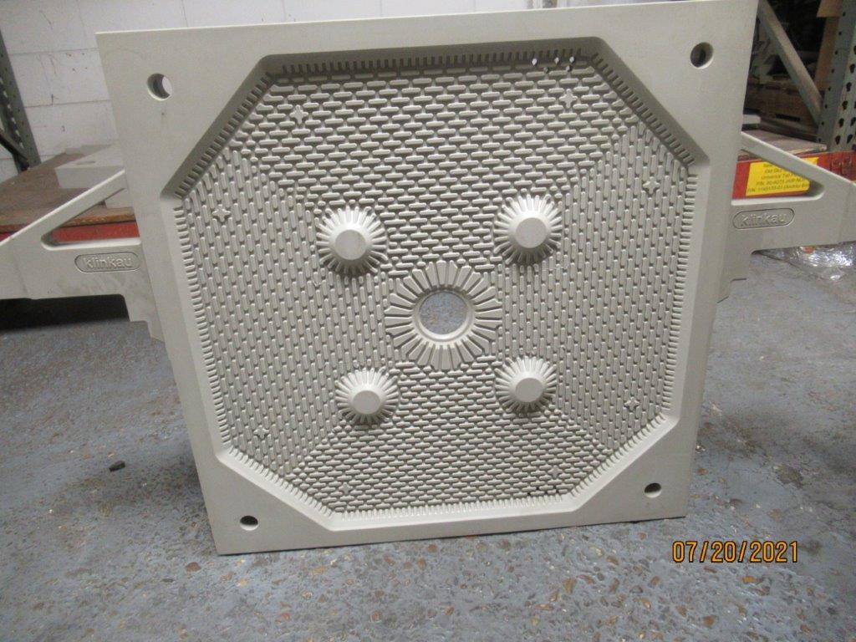
Filter Press Troubleshooting (SF2710) (w/Avery)
Potential Causes
Material incompatibilities
Insufficient cleaning schedule/procedures
Uneven Cake Buildup
Figure 5
Findings
Slurry is 3-5 wt% sodium hydroxide (caustic) in water
Also contains 500ppm-1wt% toluene
Polypropylene plates not resistant to toluene
Cloths changed when plates are changed
Cleaned by scraping
Figure

Slide 11
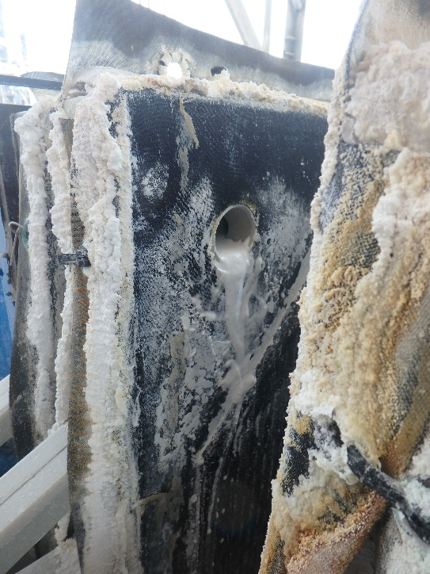
Filter Press Troubleshooting (SF2710) (w/Avery)
Solution
Communicating with supplier about different material possibilities
Suggest implementing new cleaning schedule/procedure
Cleaning or replacing cloths upon blinding
Benefits
Reduce maintenance costs
For 3 month average lifespan
Same material: ~$144,000 every 3 years
New material:
30% glass filled nylon: ~$62,000 per set
PVDF: ~$100,000 per set
Improve functionality
Figure

Slide 12
Pressure Vessel Calculations (w/ Avery)

Slide 13
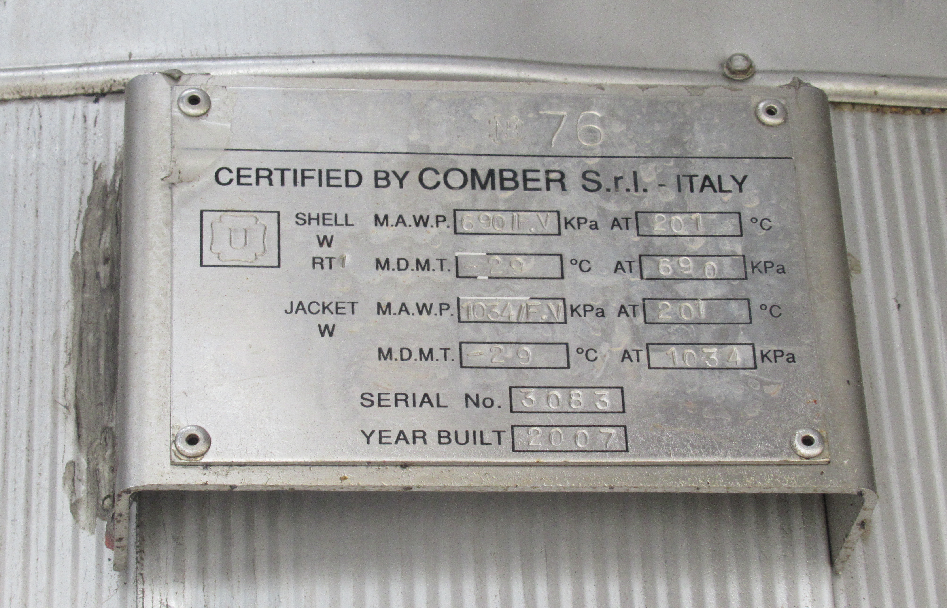
Pressure Vessel Calculations (w/ Avery)
Problem
Audit finding: Some pressure vessels are missing code calculations
Minimum Thickness
Maximum Allowable Working Pressure (MAWP)
Remaining Life Calculations
Solution
Verify which vessels are missing calculations (Avery)
Find Identifying Information for Vessels
Nameplates
U-1 forms
Drawings
Other datasheets
Figure
Notes:
Joint Project
Remaining Vessels with sufficient information

Slide 14
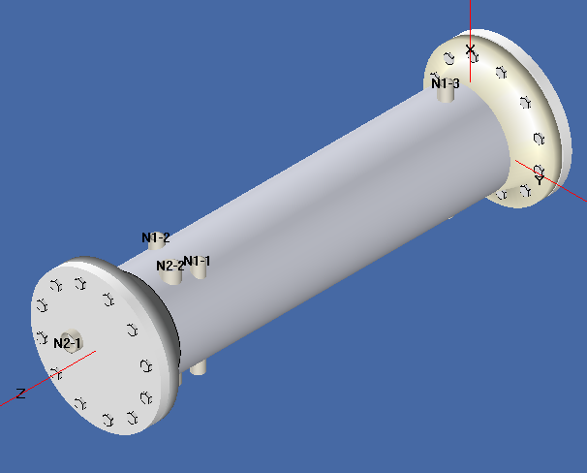
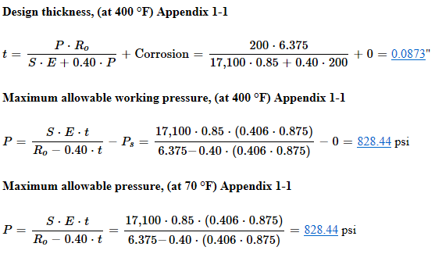
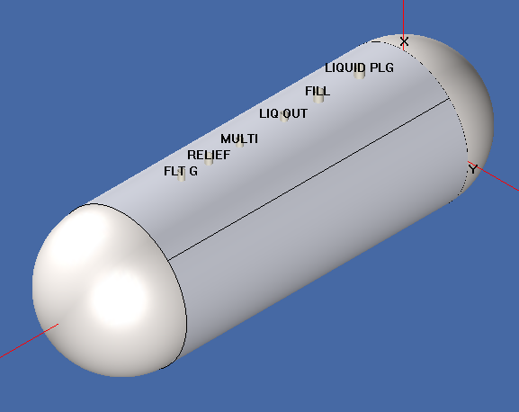
Pressure Vessel Calculations (w/ Avery)
Solution (continued)
Contact Manufacturers
Get drawings and/or code calculations
Remaining Vessels
Build out the vessels in Compress
Perform code calculations
Figure : PS-256
Figure : TPT-36
Figure

Slide 15
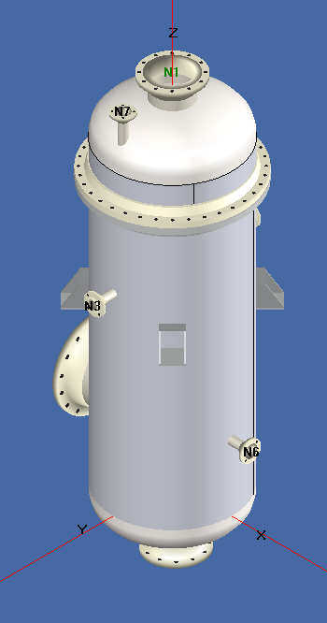
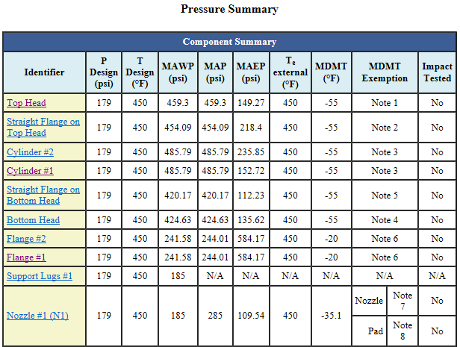
Pressure Vessel Calculations (w/ Avery)
Benefits
Created required documentation
Enhanced Safety
Remaining life calculations
Figure
Figure : D-2450

Slide 16
Rupture Disk Audit

Slide 17
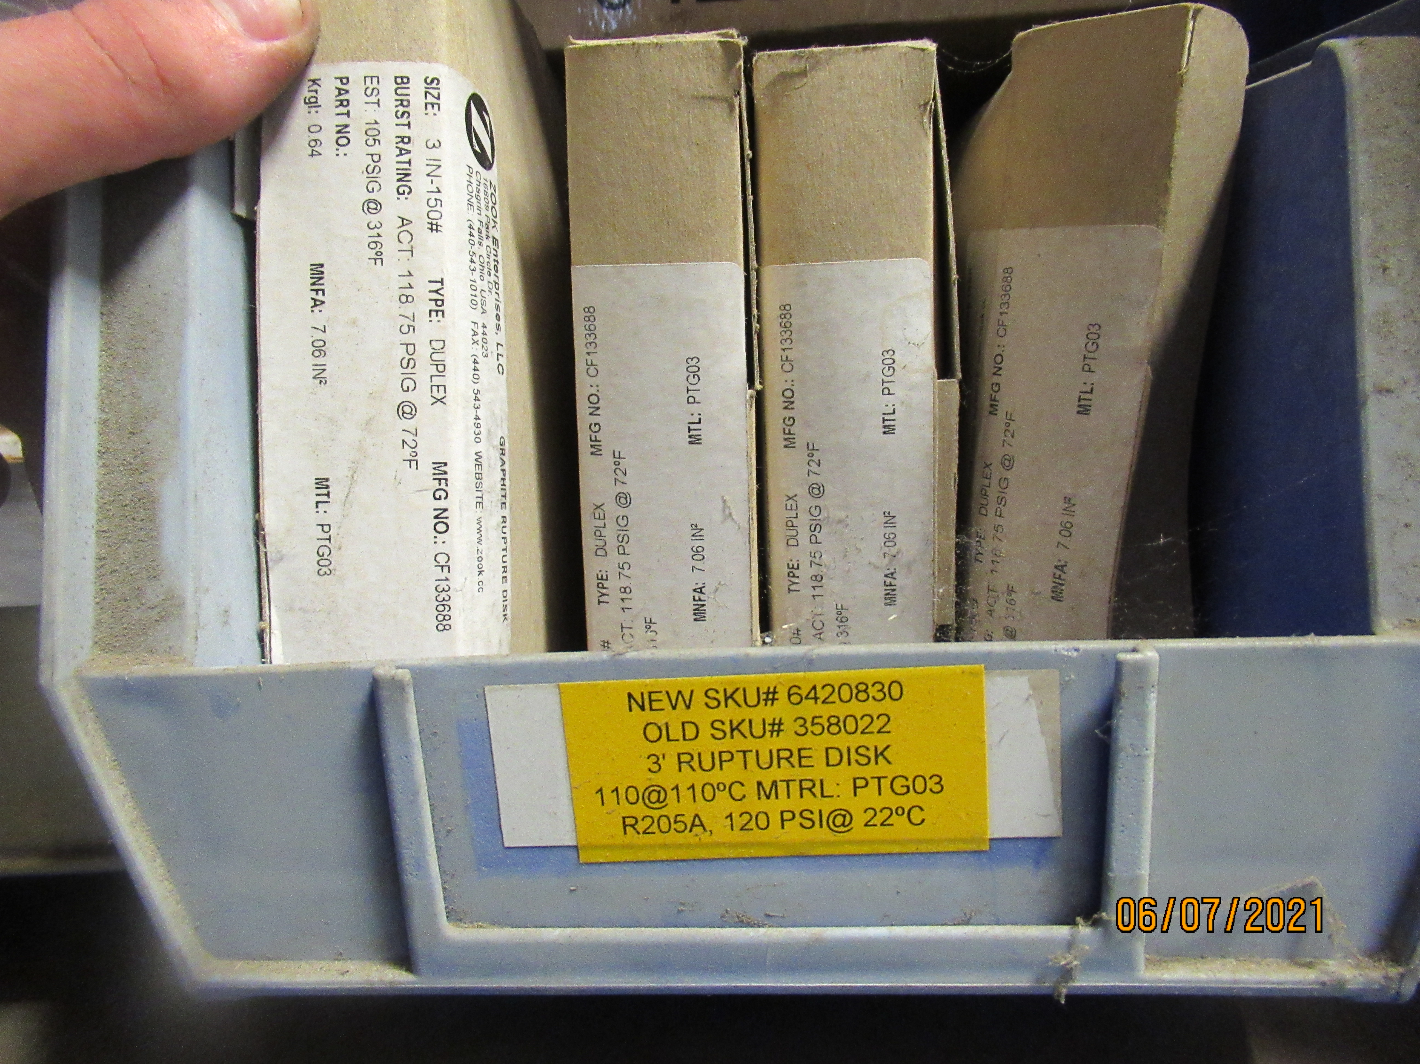
Rupture Disk Audit
Problem
Poor inventory management
Inconsistent replacement frequency
Solution
Inventory Audit
Photograph Each Label in Stores
Enter Identifying Data and Quantity into Spreadsheet
Figure

Slide 18
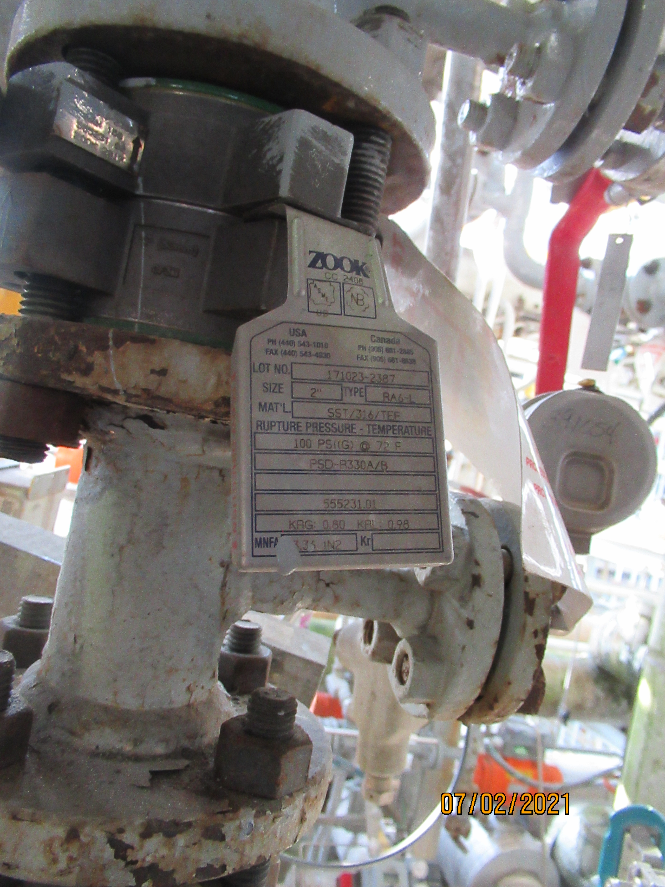
Rupture Disk Audit
Solution (continued)
Field Audit
Photograph Each Rupture Disk out in the Field
Enter Identifying Data and Quantity into Spreadsheet
Compare both Spreadsheets to Find Gaps
Identified X# of gaps
Verified inventory of X# of disks
Identified labelling issues
Disk nameplates
Piping & Instrumentation Diagrams
Benefit
Up to date inventory
Limit downtime
Limit spills
Figure

Slide 19
Specs and Standards Overhaul

Slide 20
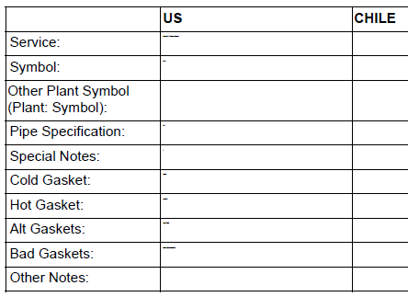
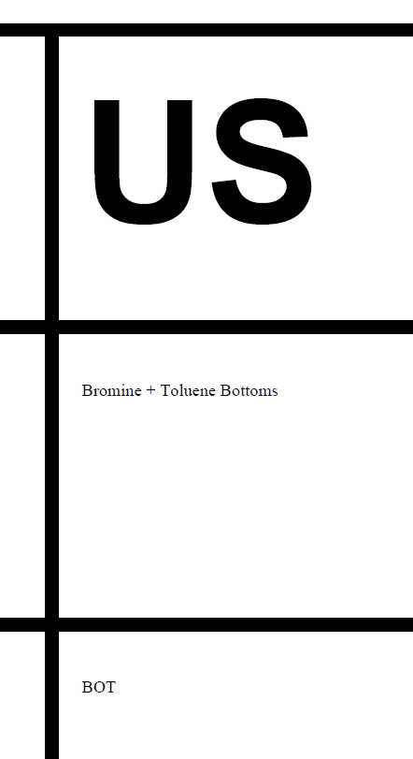
Specifications and Standards Overhaul
Problem
Current pdf format does not allow for easy editing
+1000% required to read some document tables
Figure
Figure
Notes:
Word template uses mailmerge fields
Set up the Laserfiche workflow so that it would recursively search through all the subfolders of the folder I ran it on.
Or if I gave it a document only run that document (allows for testing)

Slide 21
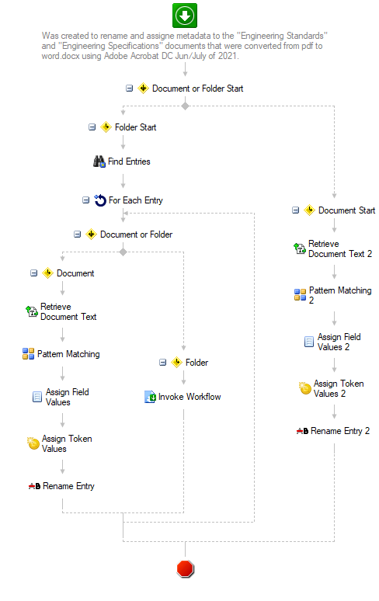
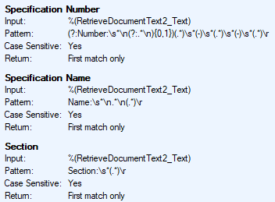
Specifications and Standards Overhaul
Solution
~900 documents
Convert from pdf to word with Adobe Acrobat DC Action Wizard
Created Laserfiche Workflows to:
Extract text data using OCR
Use RegEx to extract data from the text
Assign extracted data to document metadata
Figure
Figure
Notes:
Engineering Specifications, Engineering Standards, and Piping Specifications

Slide 22
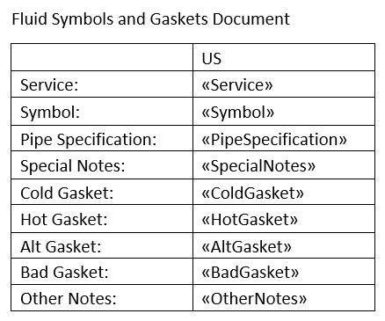
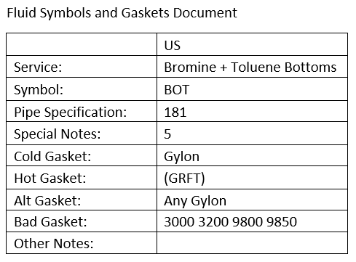
Specifications and Standards Overhaul
Solution (continued)
~7,000 documents
Created word template
Created Laserfiche Workflows to:
Extract the metadata of the pdf in Laserfiche
Fill out the template using the metadata
Assign the document to it’s new location
Figure
Benefits
Easily update as guidance changes
More accessible documentation
Figure
Notes:
Fluids Symbols and Gaskets & Valve Equals

Slide 23
Bad Actor Pumps Evaluation (w/ Avery)

Slide 24
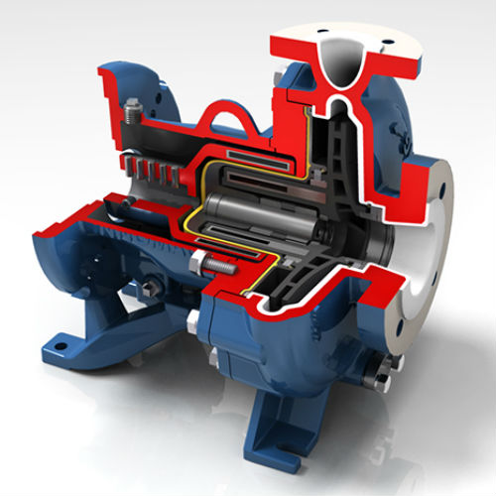
Bad Actor Pumps Evaluation (w/ Avery)
Problem
Assigned 2 bad actor pumps
P-202A mechanically sealed centrifugal pump
P-335 magnetically driven centrifugal pump
Solution
Discussed mechanics of sealed and magdrive pumps
Examined failure reports
Discussed potential troubleshooting options

Slide 25
Bad Actor Pumps Evaluation (w/ Avery)
Problem
Assigned 2 bad actor pumps
P-202A mechanically sealed centrifugal pump
P-335 magnetically driven centrifugal pump
Solution
Discussed mechanics of sealed and magdrive pumps
Examined failure reports
P-335: solids, pump running dry
P-202A: product build up, seal chamber overpressure

Slide 26
Bad Actor Pumps Evaluation (w/ Avery)
Solution (continued)
Potential troubleshooting options or solutions
P-335: identify solid & source, recirculation line, filter pot
P-202A: process chemistry, wash, tattletale
Benefits
Figure
Revisit problem
Learning opportunity

Slide 27
Bad Actor Pumps Evaluation (w/ Avery)
Problem
Failure reports not combined anywhere
Big picture is hard to see
Solution
Created Summary of Failure Reports
Uses Laserfiche forms
Can adjust filters to select specific equipment
Can automate generation
Benefit
Easier to troubleshoot
Big picture is clearer

Slide 28
Vendor Visits

Slide 29
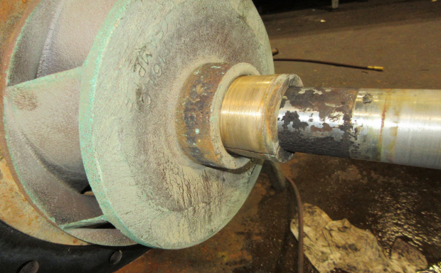
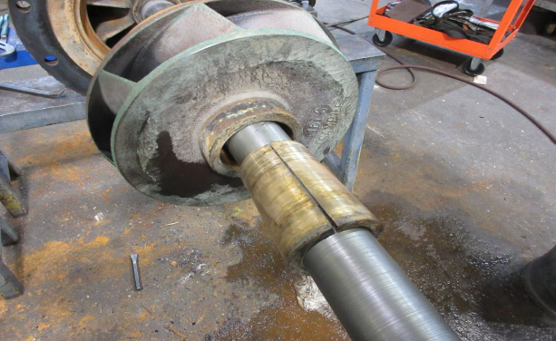
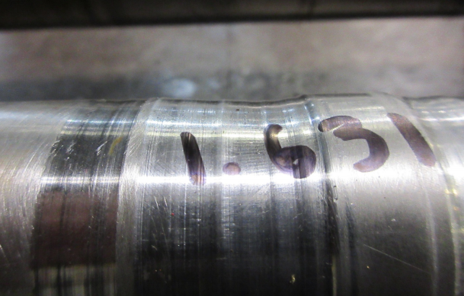
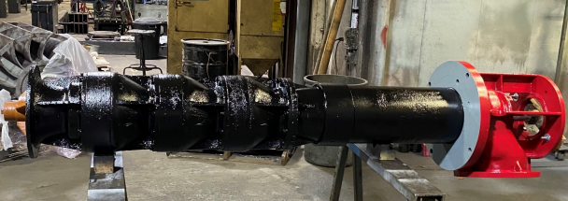
Vendor Visits
AWC PSV Valve Shop Tour
Demonstration of inventory management software
Tour of shop and inventory
Explanation of valve testing bench
Instrument and controls training area
Firewater Pump
Figure
Potential reasons for failure
Inspection of pump components
Approval of repairs and changes
Figure
Figure
Notes:
PSV valve shop
And manual and CV?
Which other?

Slide 30
Miscellaneous

Slide 31
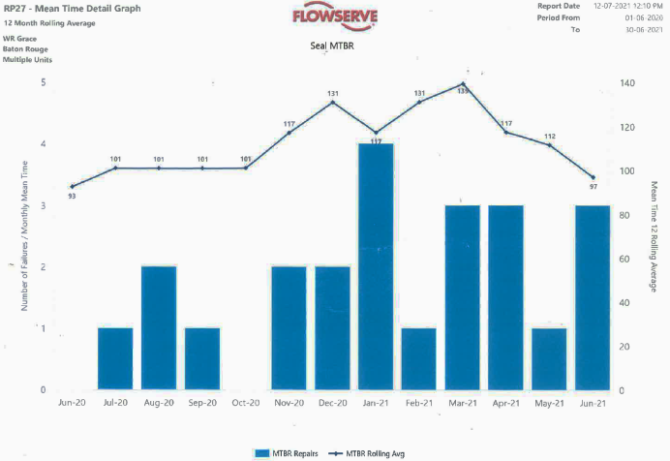
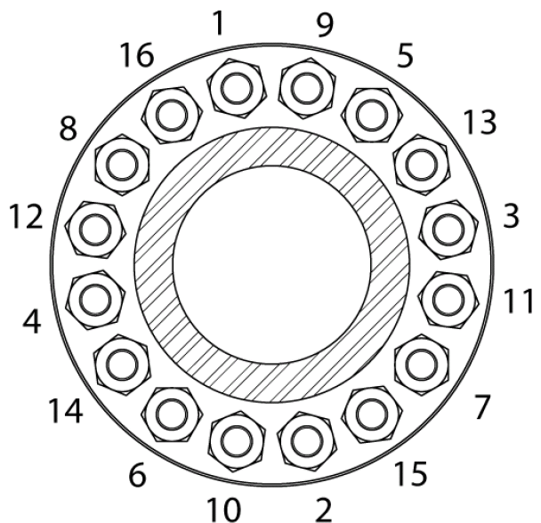
Miscellaneous
MDUN meetings
Maintenance meetings
Cover ongoing projects
Discuss new issues
Flowserve meetings
Reliability metrics
Pump and seal failures for month
Potential long term solutions
Figure
BJFA Training
Helped evaluate presentation and quiz
Attended training
Figure

Slide 32
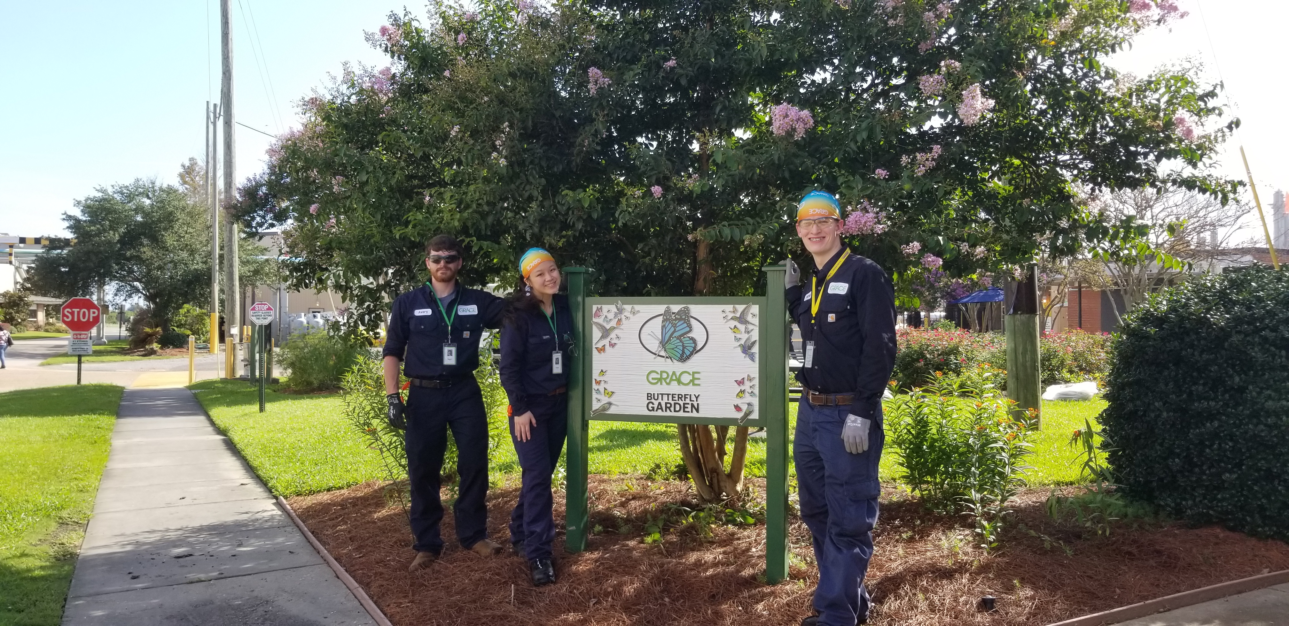
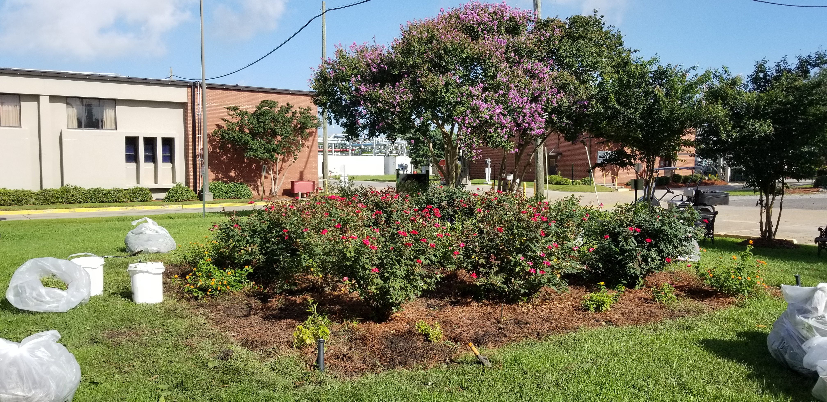
Butterfly Garden Enhancement
Pulled weeds and transplanted plants
Wildlife Habitat Tour
Documented wildlife
Importance
Increases biodiversity
Supports conservation
WHC silver certification
Corporate adoption
Figure
Analytical Labs Tour
NMR, ICP, DSC, Titration
Figure

Slide 33
Closing

Slide 34
Closing
Acknowledgements
Nicole Stein
Daniel Dragland
Todd Stephens
Joe Haley
Bob Gallant
Debbie Meyer
Angelle Forrest
Tommy Ray
Catherine Morejon-Garcia
Jeremy Quirk
Lakeisha Butler
Gaya Elpitiya
Terry Temple
Jonathon

